Slide 1
Texas Wildfire March 2022

Slide 2
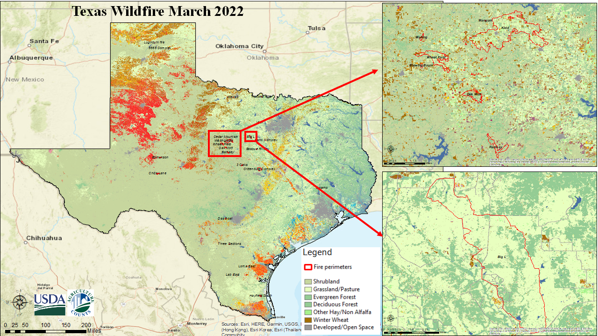

Slide 3
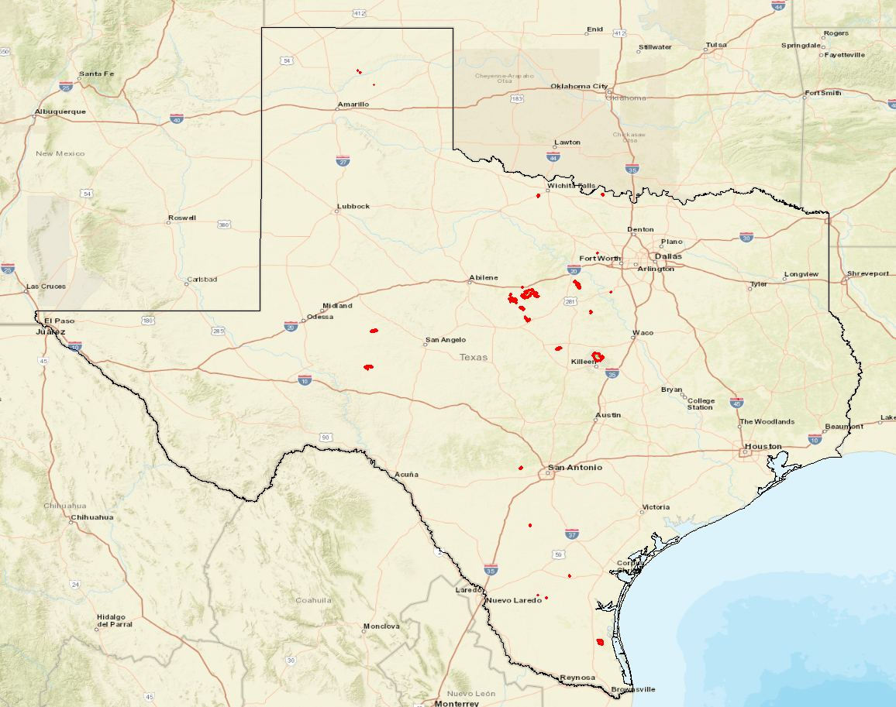

Texas Wildfire March 17-28, 2022
High winds, low humidity, and drought-parched grasses have caused wildfires across the Southern Plains of the United States since mid-March 2022, including Texas.
https://earthobservatory.nasa.gov/images/149608/dry-winds-and-grasses-fuel-texas-fires
Fire polygons are provided by National Interagency Fire Center

Slide 4
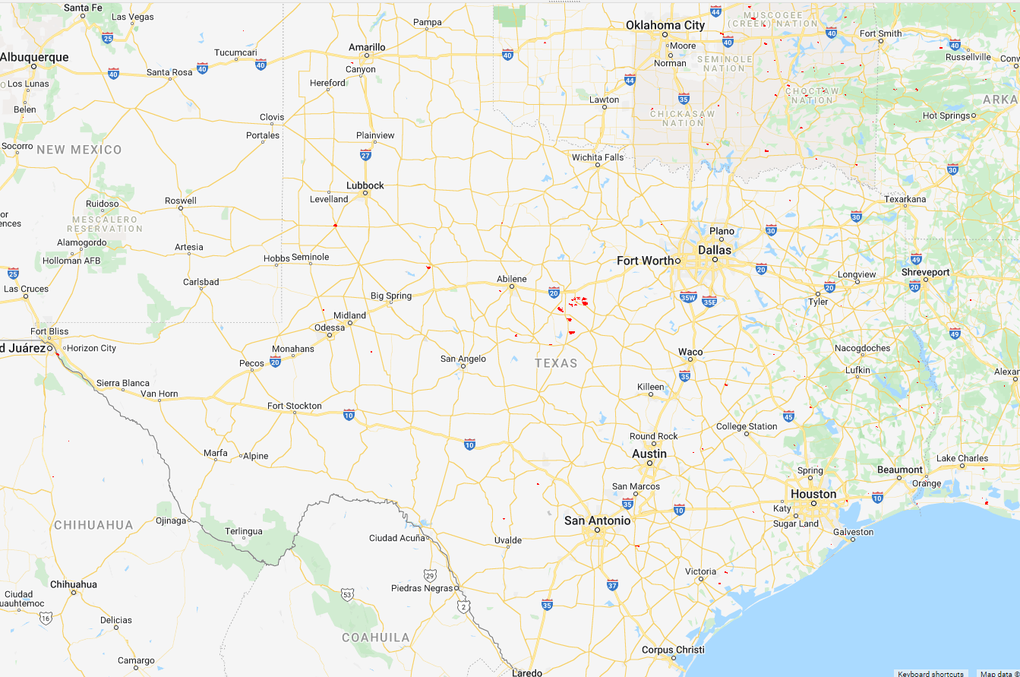
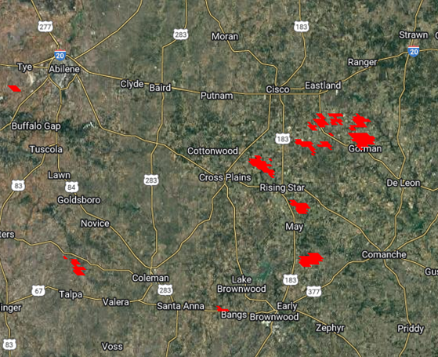
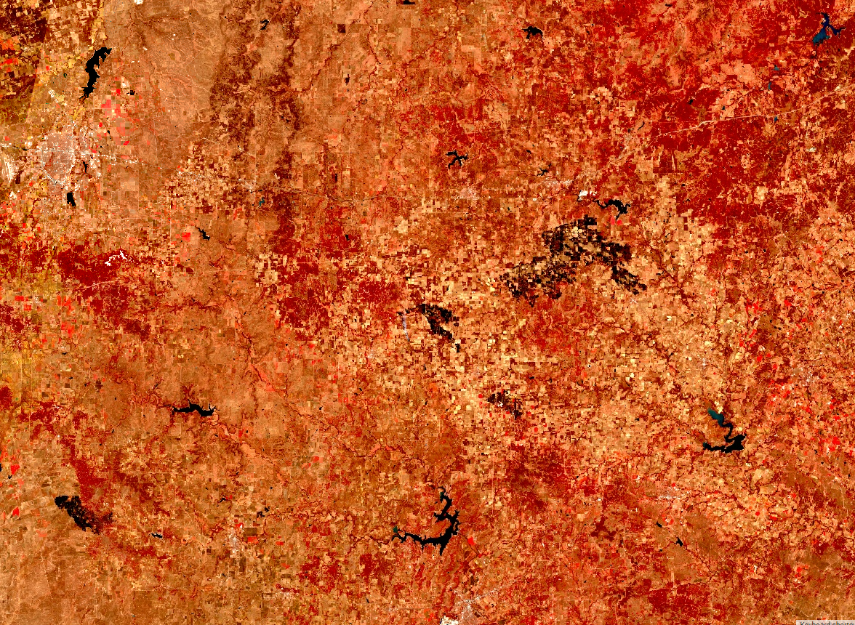
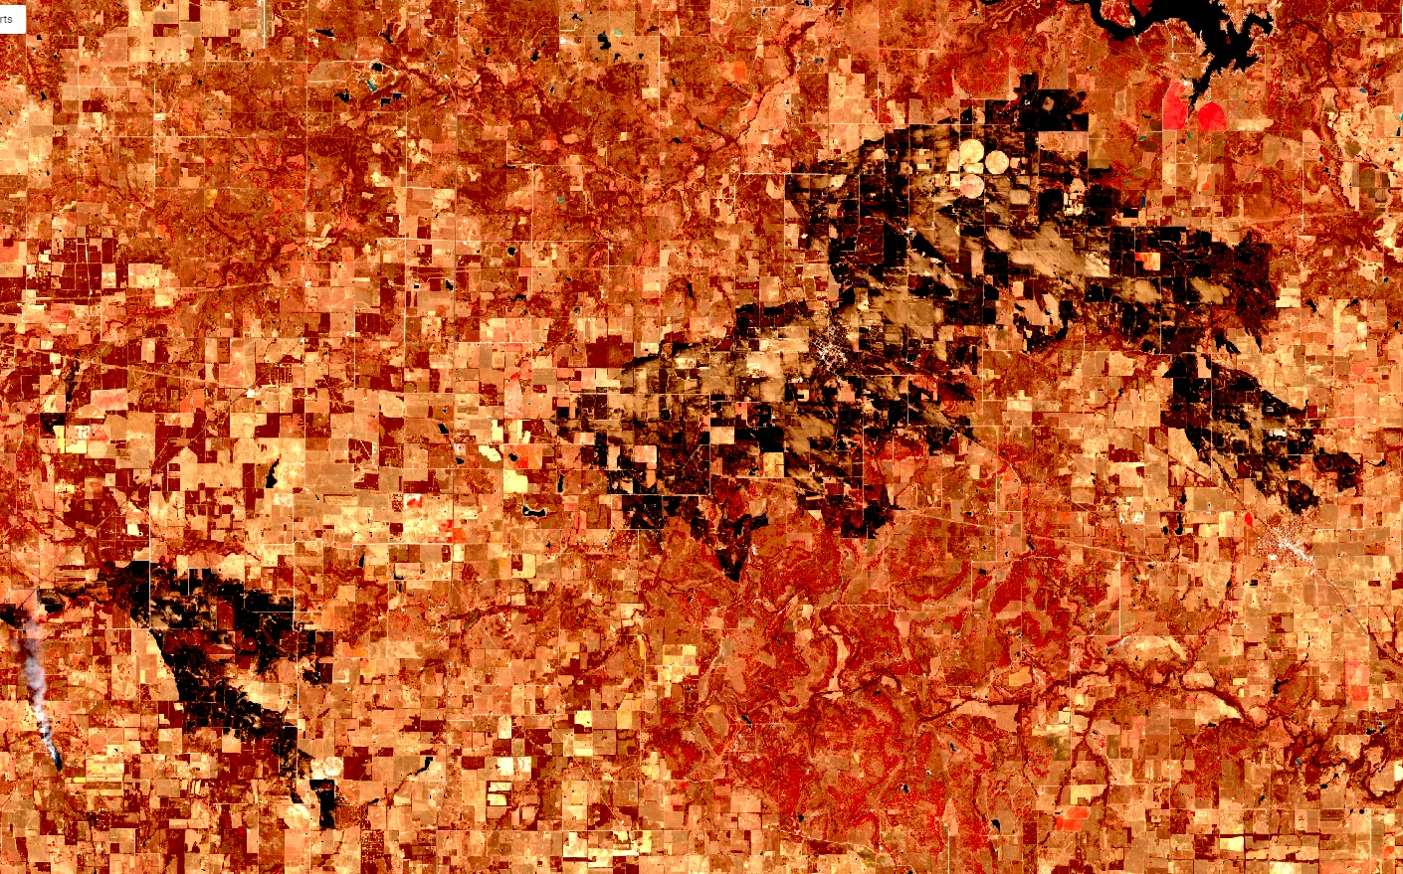
Fire masks derived from MODIS Terra Thermal Anomalies & Fire Daily Global 1km Product March 17 – 21, 2022
Fire detected from MODIS Imagery 180 miles west of Fort Worth, Texas
Fire scars detected on Sentinel-2B image of March 20, 2022

Slide 5
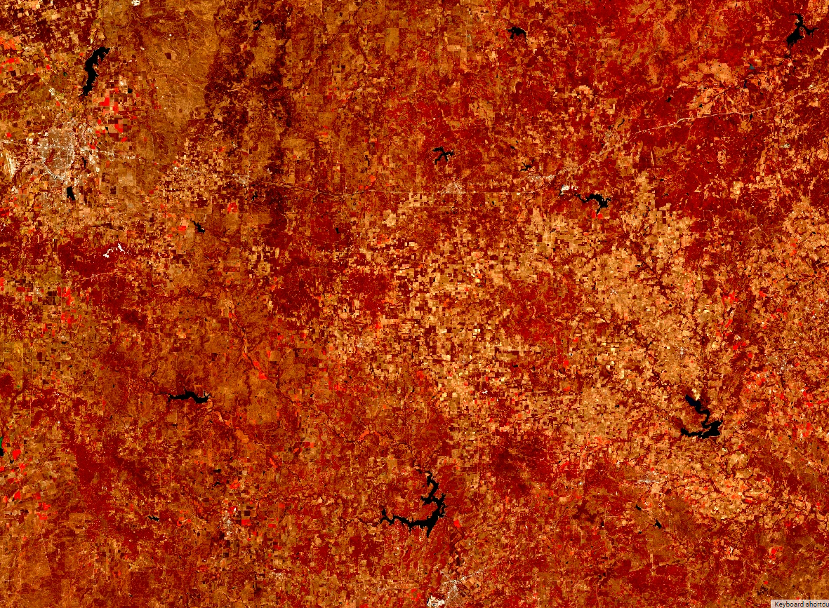
Fire scars detected 180 miles west of Fort Worth, Texas from Sentinel-2B image acquired on March 20, 2022
Image before the fires (median image of January 1 – February 28, 2022)
Image after the fires (March 20, 2022)

Slide 6
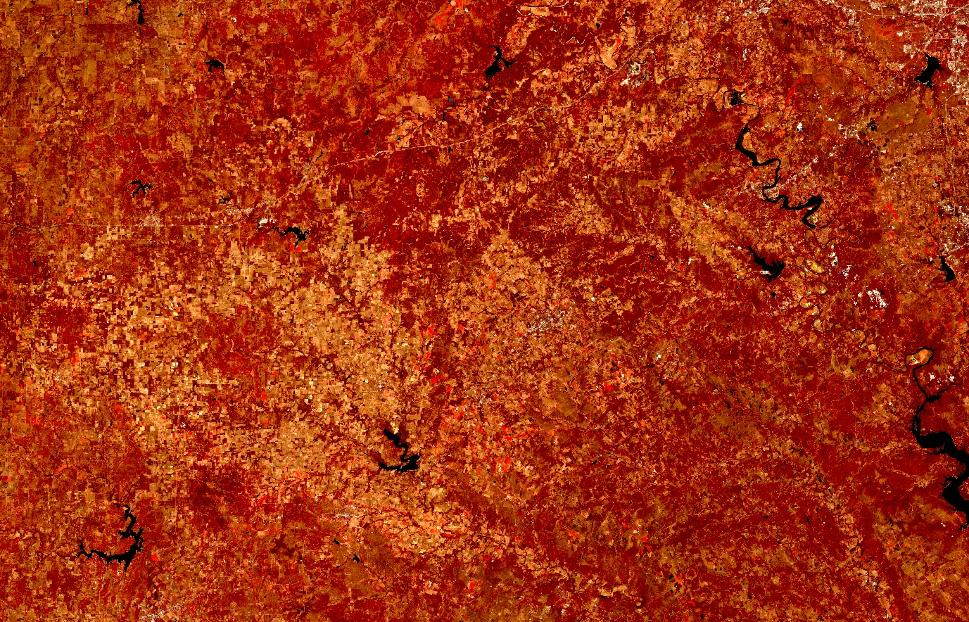
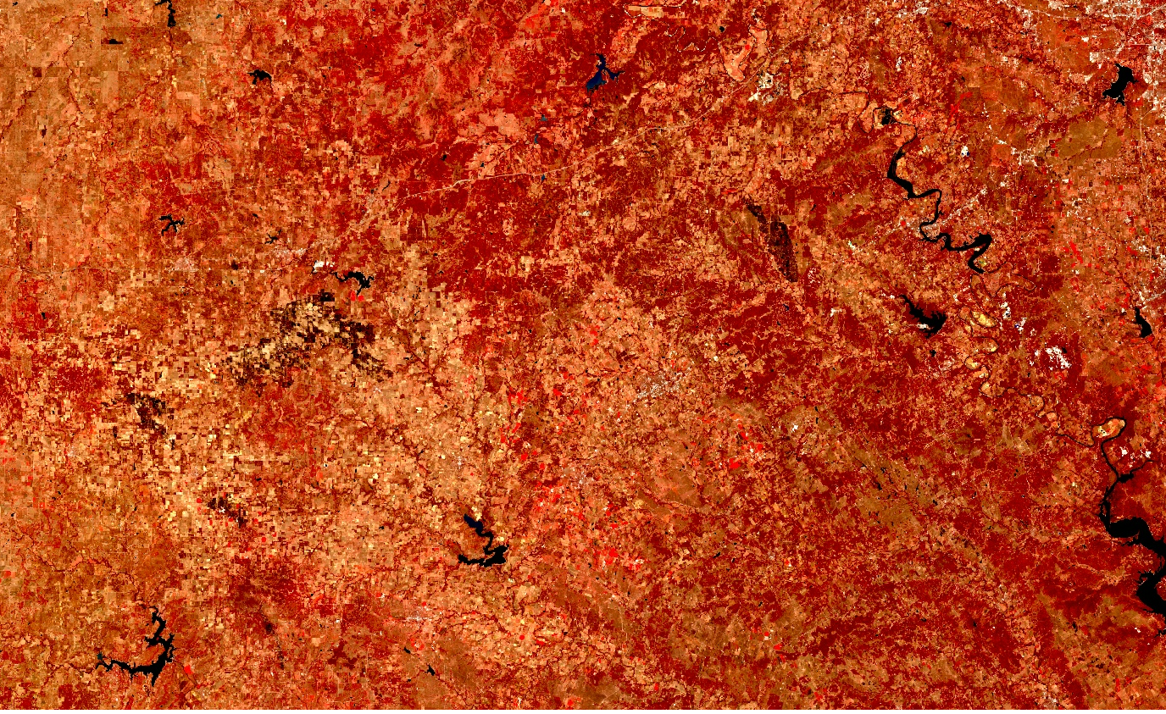
Fire scars detected 180 miles west of Fort Worth, Texas from Sentinel-2A image acquired on March 25, 2022
Big L
Kidd
Image before the fires (median image of January 1 – February 28, 2022)
Image after the fires (March 25, 2022)

Slide 7
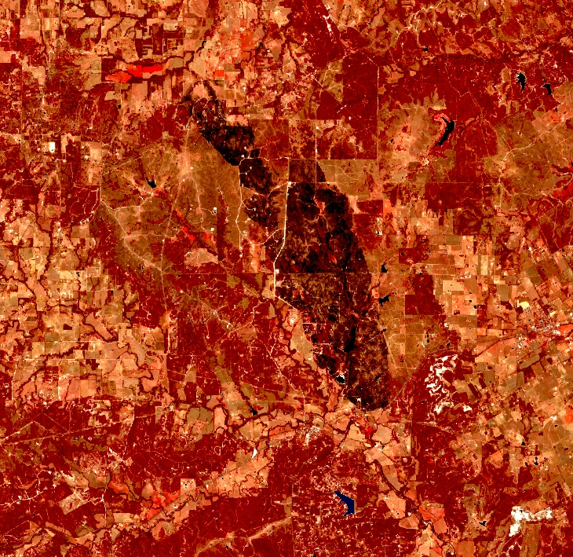
Fire scars detected 180 miles west of Fort Worth, Texas from Sentinel-2A image acquired on March 25, 2022
Big L
Kidd
Image after the fires (March 25, 2022)

Slide 8
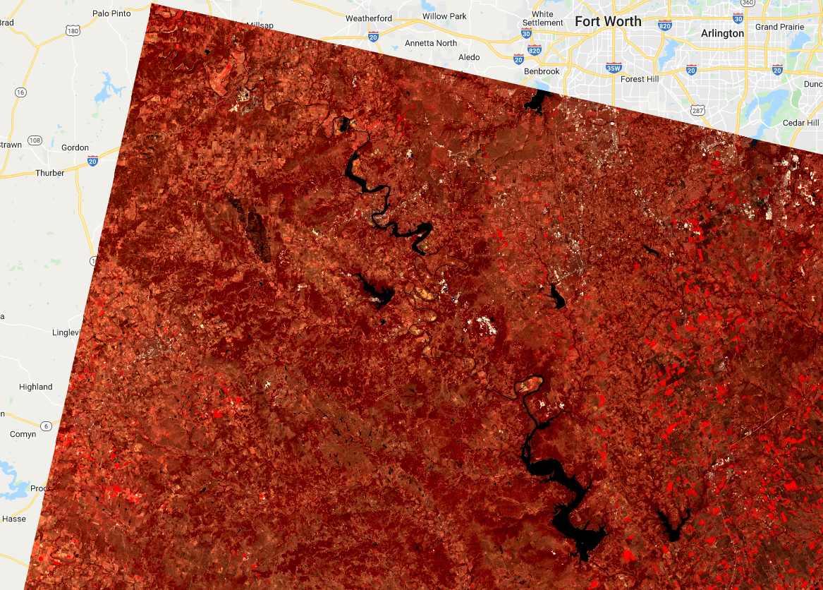
Fire scars detected from Landsat-9 image acquired on March 25, 2022
Big L

Slide 9
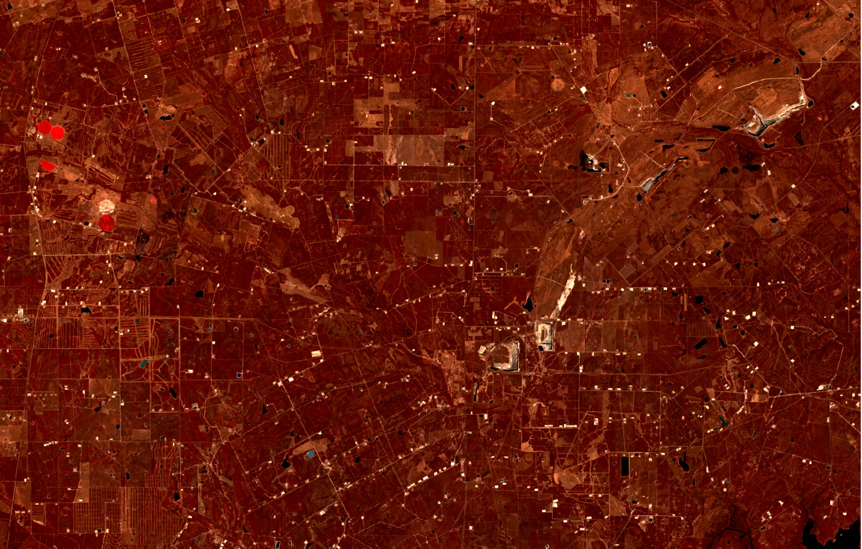
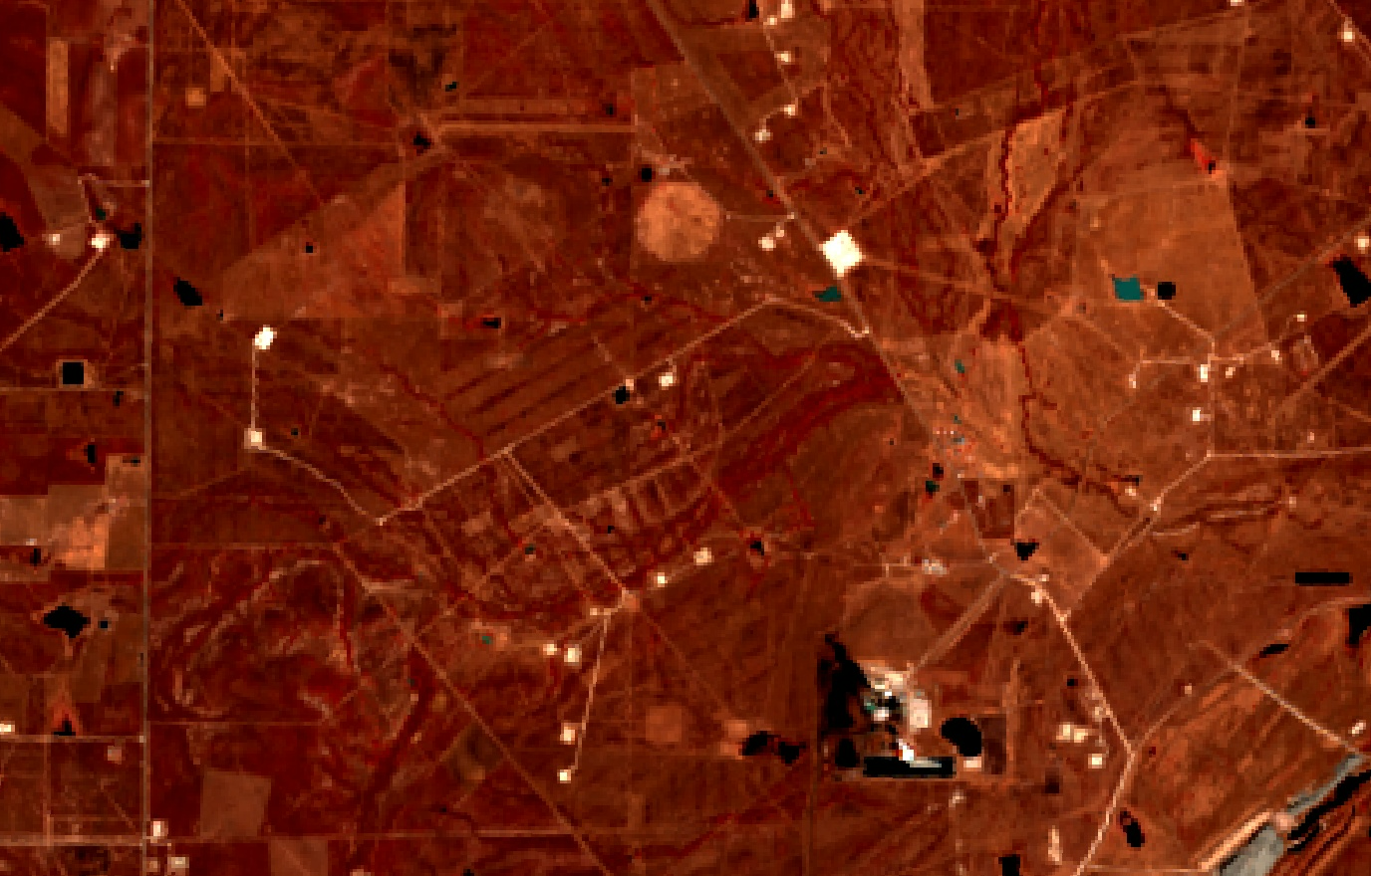
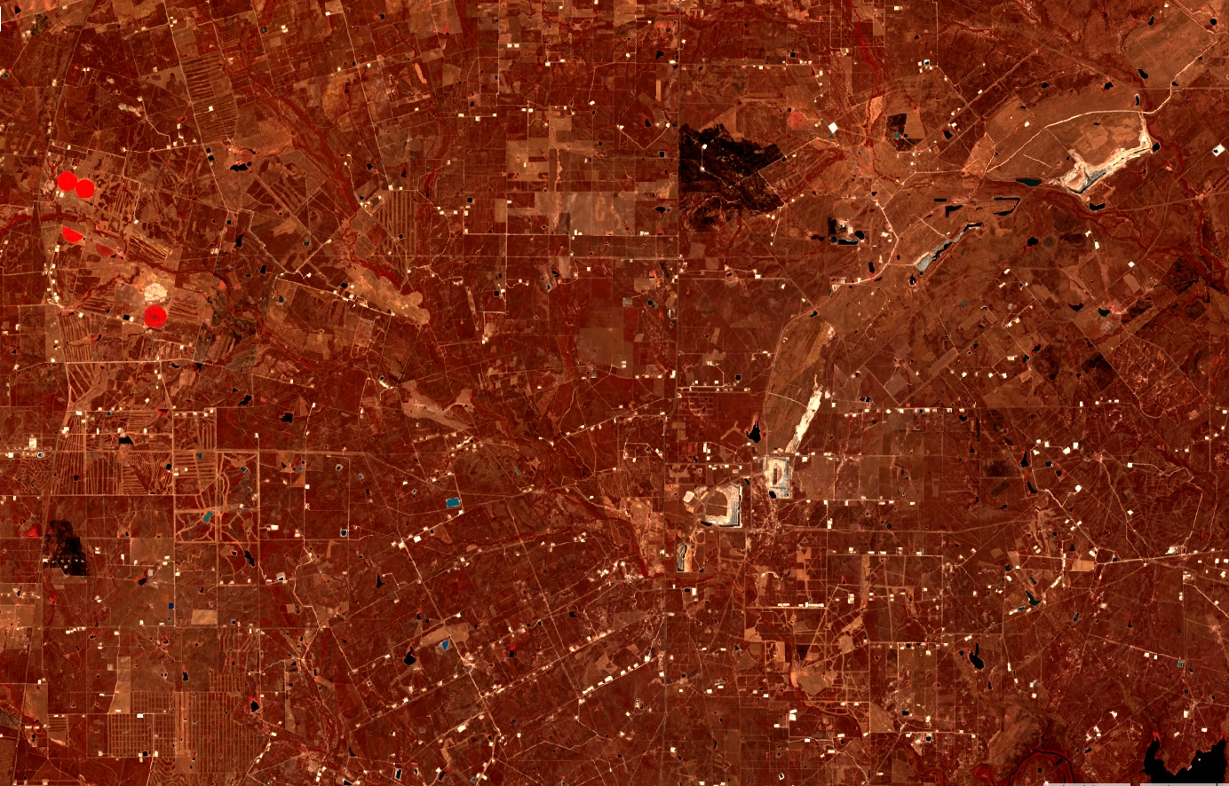
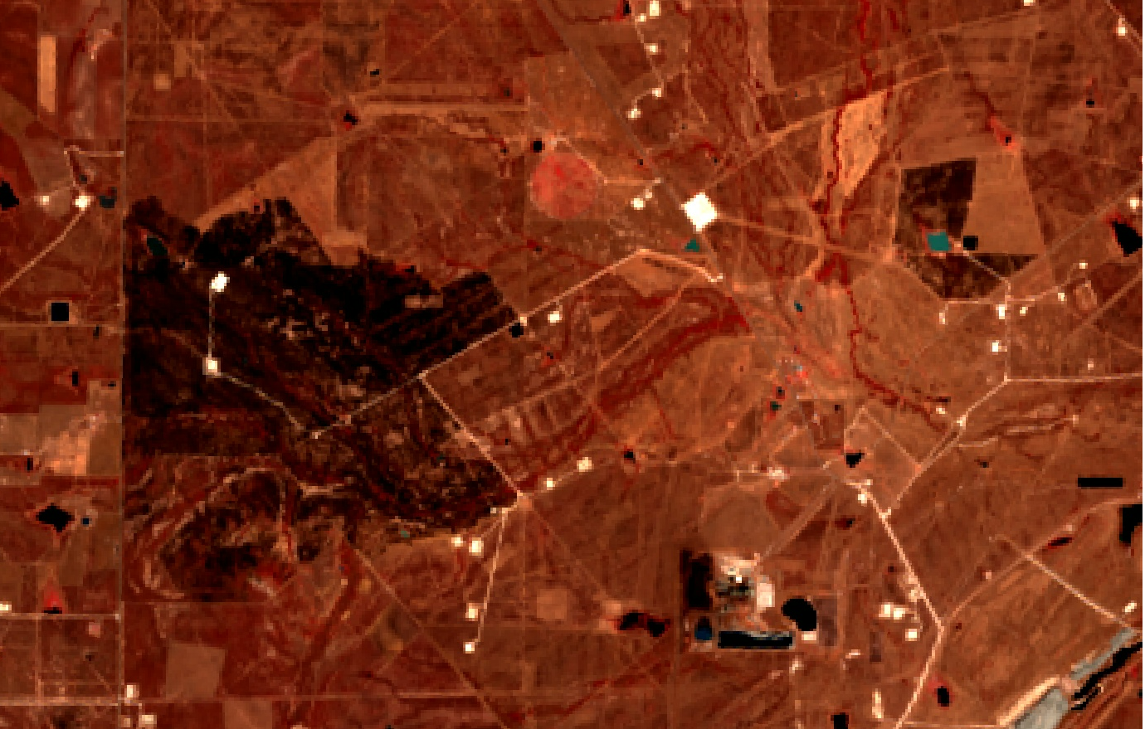
Fire scars detected from Landsat-9 image acquired on March 25, 2022
Before
Before
After
After

Slide 10
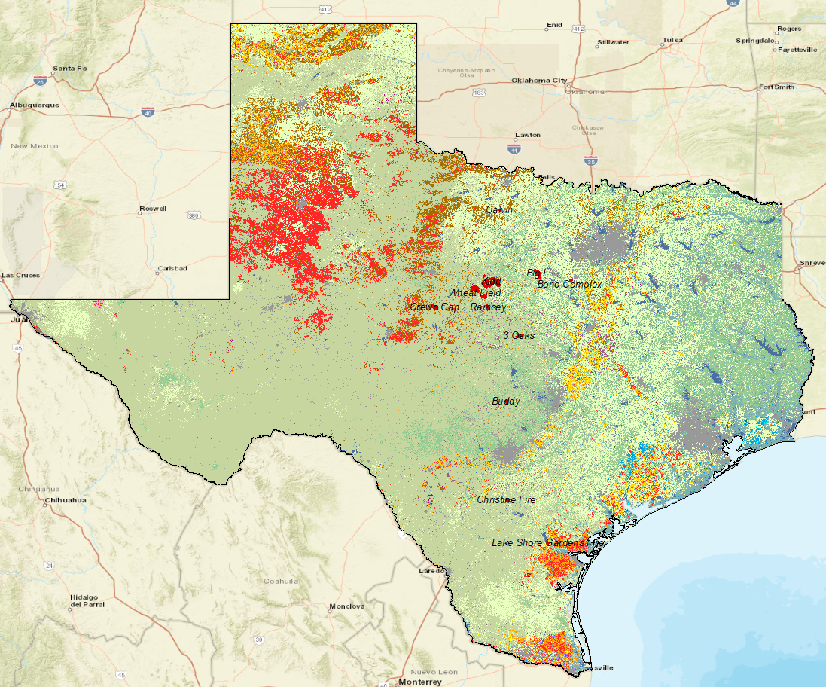
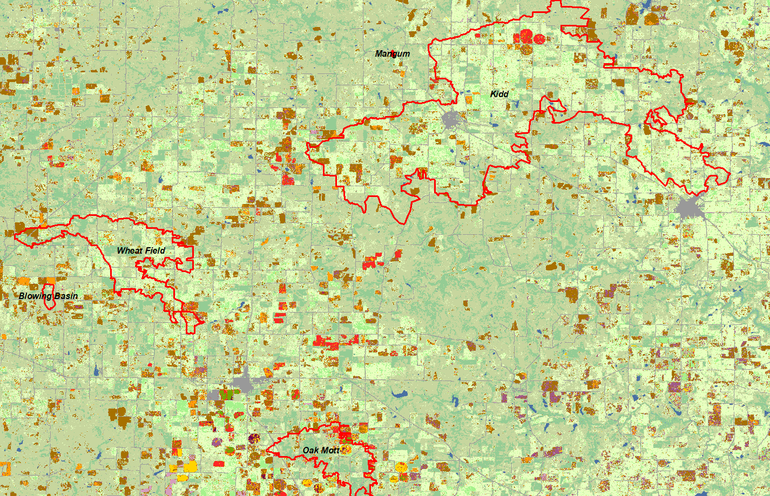
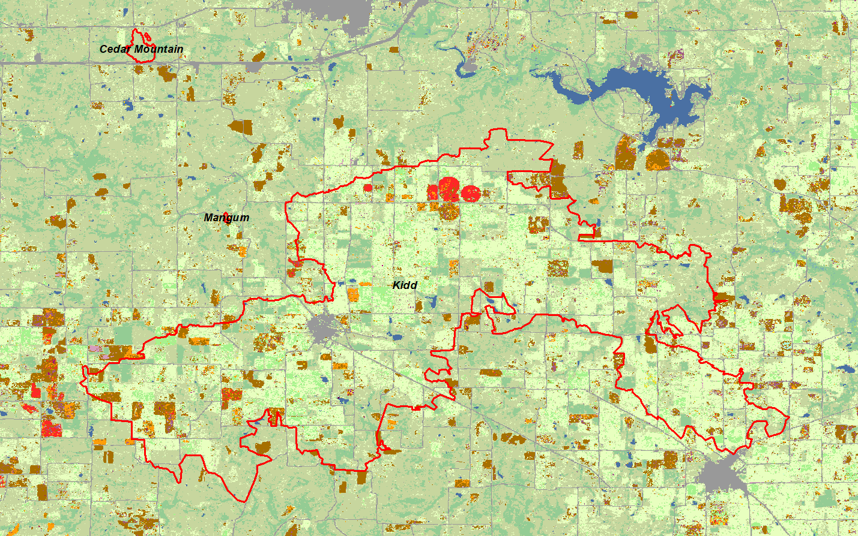
USDA NASS Cropland Data Layers 2021 - Texas

Slide 11
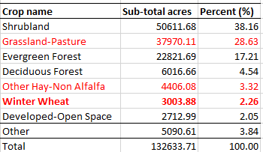
Percent of landcovers within all fire polygons
USDA NASS Cropland Data Layers 2021 - Texas
0.05%
99.95%
The top 7 landcovers occupied 96.16% of total fired area, where winter wheat accounted for 2.26% of the impacted area. Impacted winter wheat accounted for 0.05% of the total state-wide surveyed winter wheat area.
Winter wheat within fire polygons: 3003.88 acres
Winter wheat state-wide (2021 survey): 5,500,000 acres

