Slide 1
Hurricane Idalia - August 2023
Assessment Period: August 30-31, 2023
Publication Date: September 14, 2023
USDA NASS
Disaster Monitoring Team

Slide 2
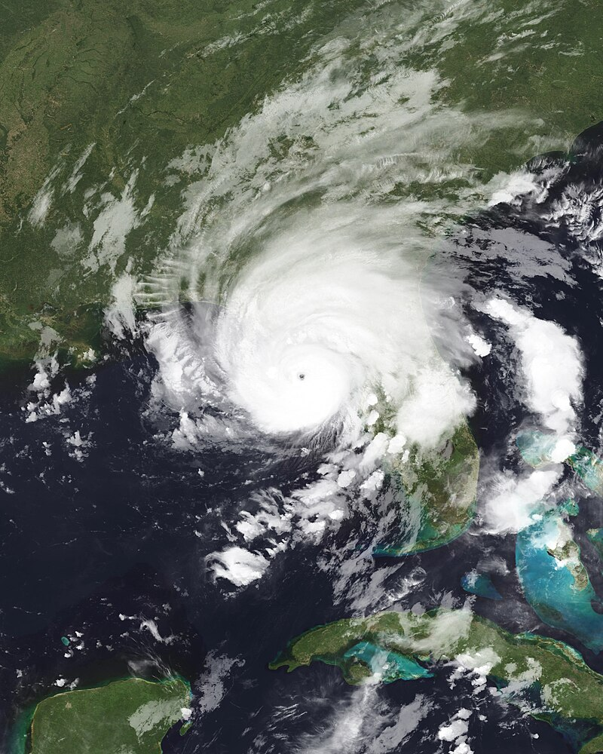
Event Summary
Location: Southeastern United States, including Florida, Georgia, South Carolina, and North Carolina
Event: Hurricane Idalia
  Category 4 Atlantic hurricane
Timeframe: August 30-31, 2023
August 30, 2023, NOAA VIIRS
https://www.gdacs.org/report.aspx?eventid=1001000&episodeid=29&eventtype=TC#:~:text=Tropical%20cyclone%20IDALIA%20made%20landfall,weakening%20as%20a%20tropical%20storm.

Slide 3
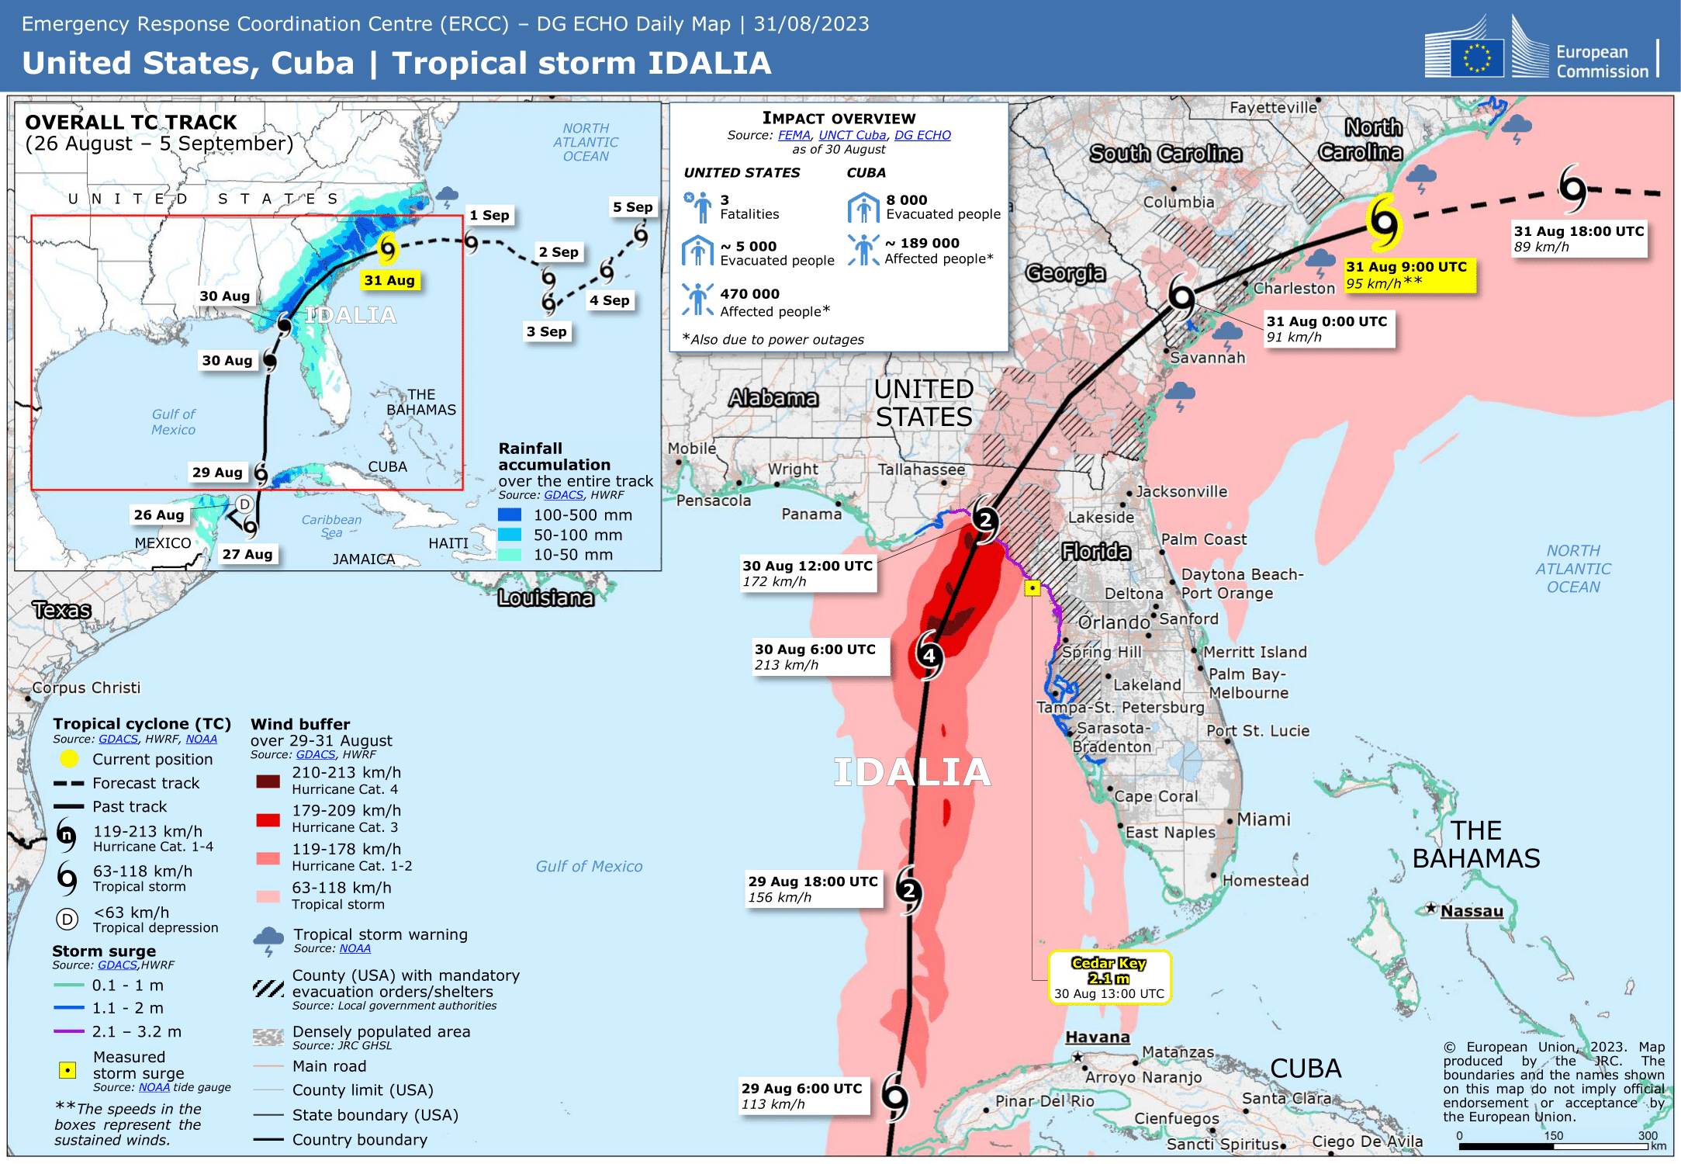
https://www.gdacs.org/report.aspx?eventid=1001000&episodeid=29&eventtype=TC#:~:text=Tropical%20cyclone%20IDALIA%20made%20landfall,weakening%20as%20a%20tropical%20storm.

Slide 4
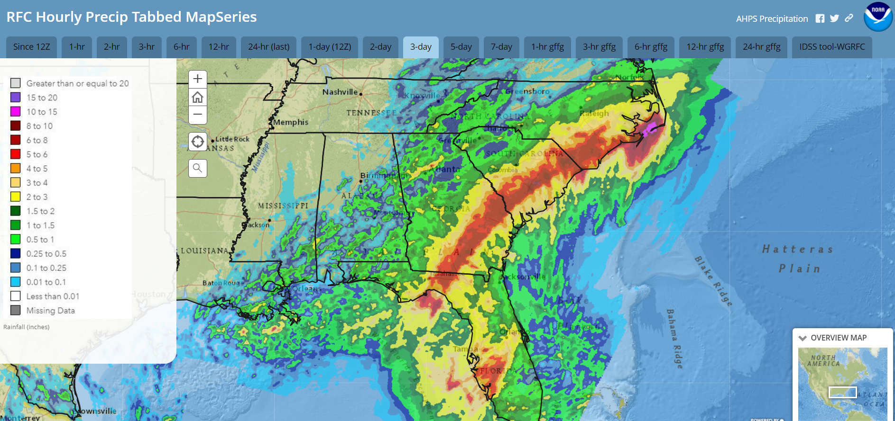
Observed 3-Day Precipitation Levels: August 30 – September 1 (2023)
https://noaa.maps.arcgis.com/apps/MapSeries/index.html?appid=ed433140c2a24b67aa9f19d2e3ea1977

Slide 5
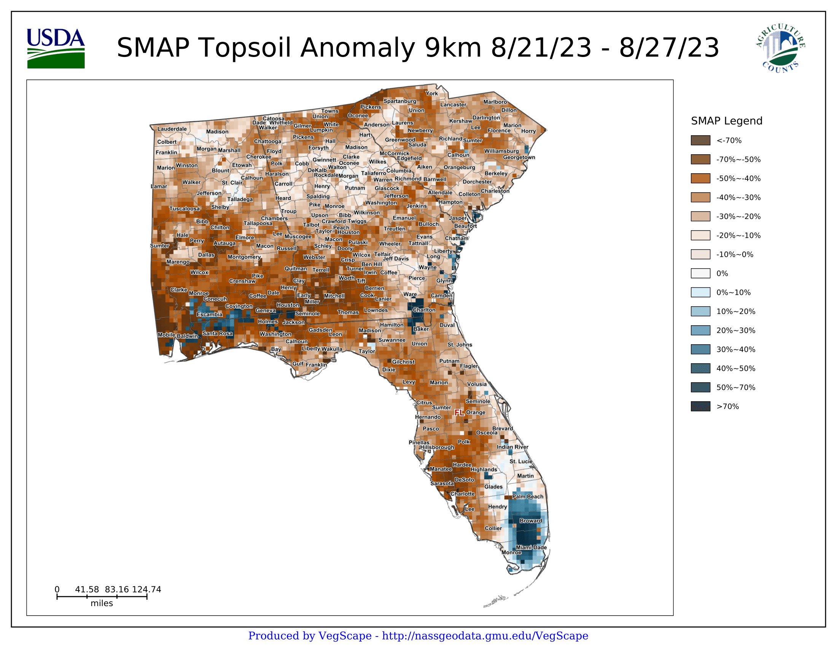
Pre-Event

Slide 6
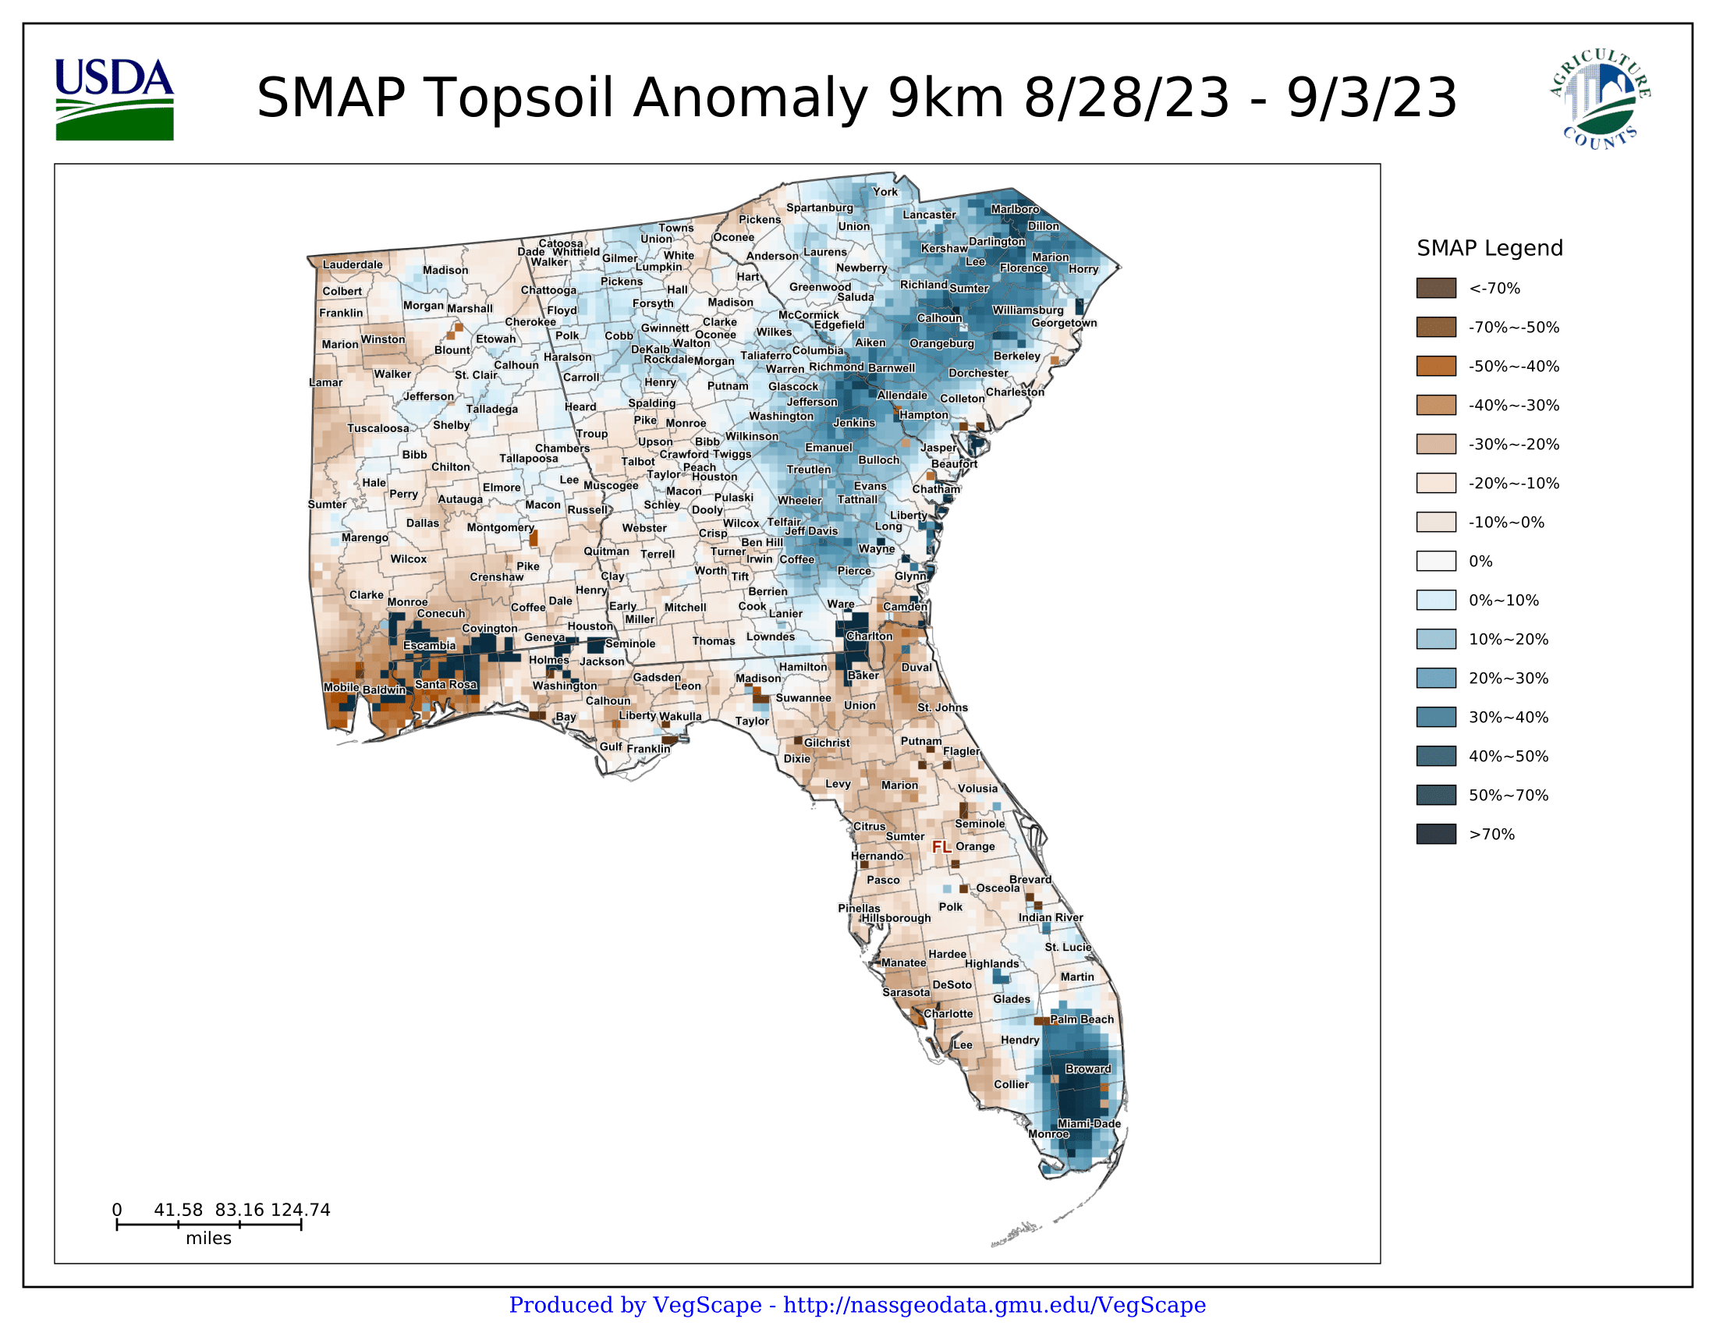
Post-Event

Slide 7
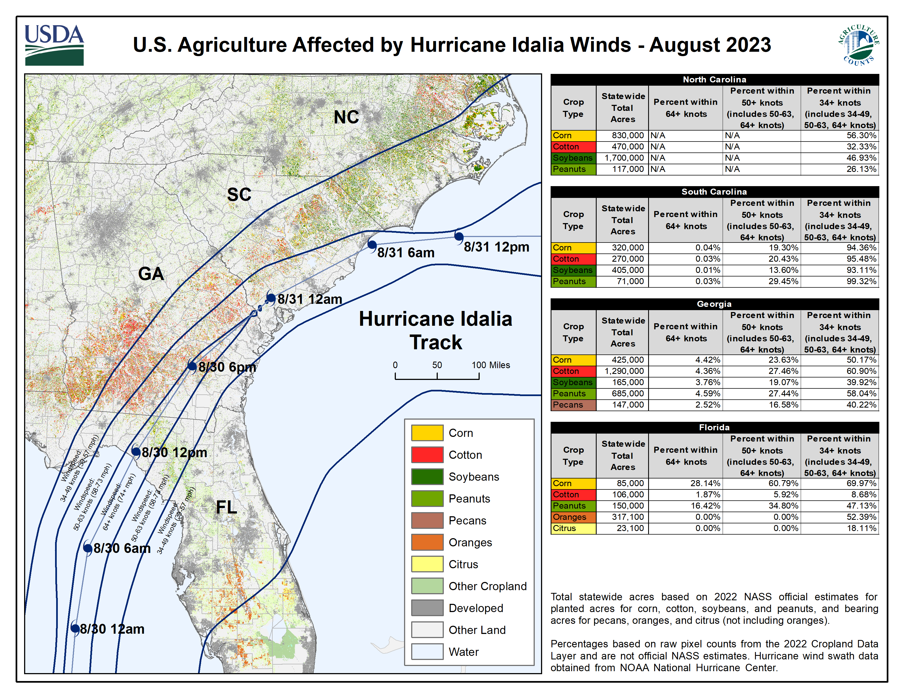

Slide 8
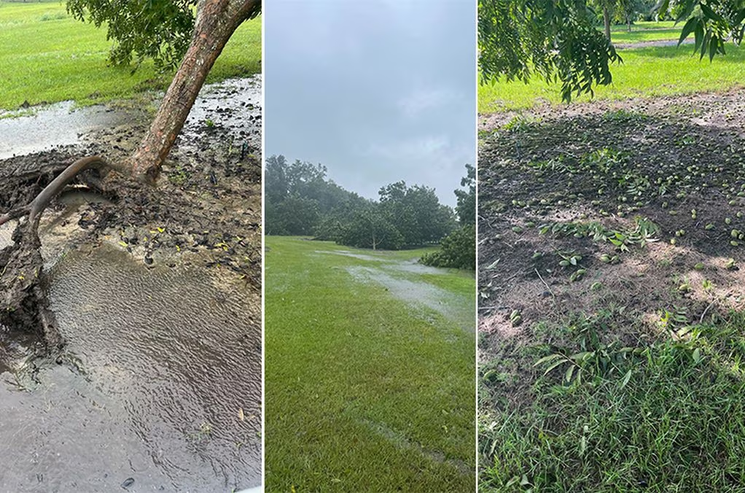
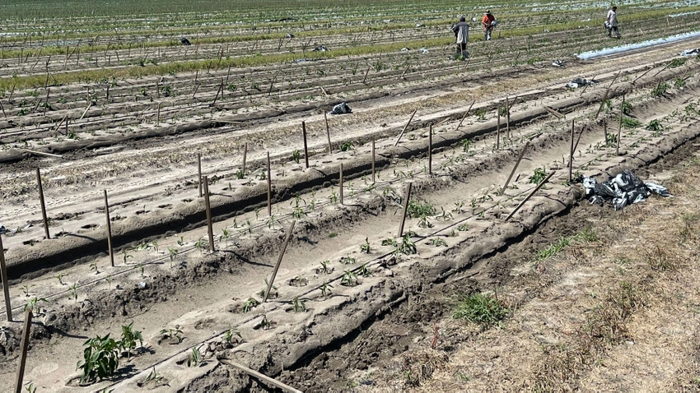
Ground Photos: Reported Crop Damage (GA, FL)
Dixie, GA: Heavy damage to pecan orchards near the GA-FL border.
Photo Source: Special to AJC
Media Source: Downed trees, twisted cotton: Georgia farms hit hard by Idalia
Jennings, FL: Several hundred acres of eggplants and peppers lost by one grower.
Photo Source: De Broughton
Media Source: Idalia hit Florida, Georgia agriculture

